Slide 1
CELL DEFENDER
DENNISON DAVID

Slide 2
Overview
Target Audience
Motivation
How does it help?
Bottomline: This was the only Biological scenario I knew I could design in the time period.
Instead of a cell you could have the protagonist explore DNA or protein sequences . Across different organisms!

Slide 3
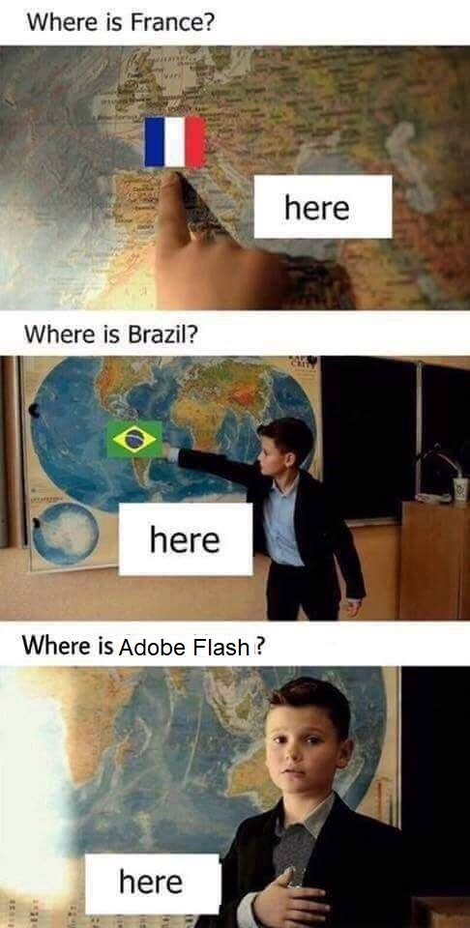
TOOLS
Adobe Animate CC
Adobe Photoshop CC
MS Paint

Slide 4
WHY FLASH? ☹
For the retro charm / nostalgia quotient.
Not because it’s easier, cos it’s not.
And yes, Flash is dead. (circa 2015, but not officially)
Its successor is HTML5.

Slide 5
SHOW us the game already!
A walkthrough:

Slide 6
IMPROVEMENTS & Future work
Create a start menu
Create a death screen
Include more sprites
Expand the overworld
Change the scenario?
Add character sounds
More weapons?
Make it procedurally generated
Introduce PACMAN as ally.

Slide 7
Questions?
THANK YOU ^_^

